Slide 1




Sales prediction
Project Id:- PRCL-0019-SALES-PRED Sales prediction
Project Team Id:- 1107
Team Members:-
Ayush Mehta
Ali Hasan

Slide 2
INTRODUCTION
FicZon Inc is an IT solution provider with products ranging from on- premises products to SAAS based solutions. FicZon major leads generation channel is digital and through their website.
FicZon business is majorly dependent on the sales force effectiveness. As the market is maturing and more new competitors entering the market, FicZon is experiencing the dip in sales.
Effective sales is dependent on lead quality and as of now, this is based on manual categorization and highly depended on sales staff. Though there is a quality process, which continuously updates the lead categorization, it’s value is in for post analysis, rather than conversation.
FicZon wants to explore Machine Learning to pre-categorize the lead quality and as result, expecting significant increase in sales effectiveness.

Slide 3

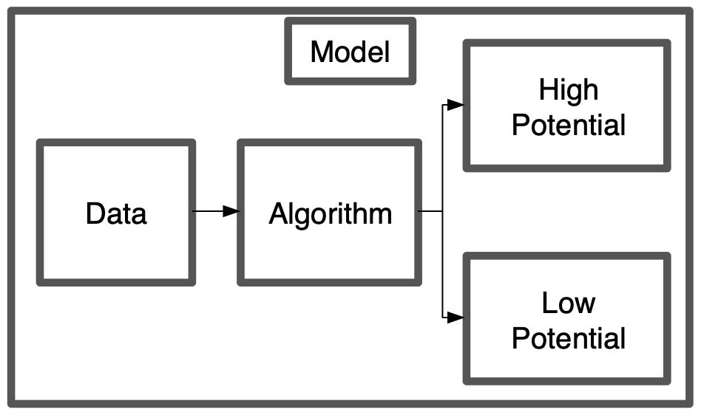
Project Goal
Data exploration insights – Sales effectiveness.
Model to predict the Lead Category (High Potential , Low Potential)

Slide 4
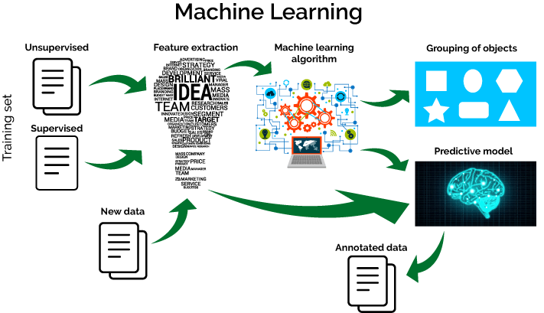
Machine Learning
Machine Learning (ML) is all about algorithms that can tell you something about a set of data without you having to write any custom code specific to the problem; i.e., instead of writing code, you feed data to the generic algorithm and it builds its own logic based on the data.

Slide 5
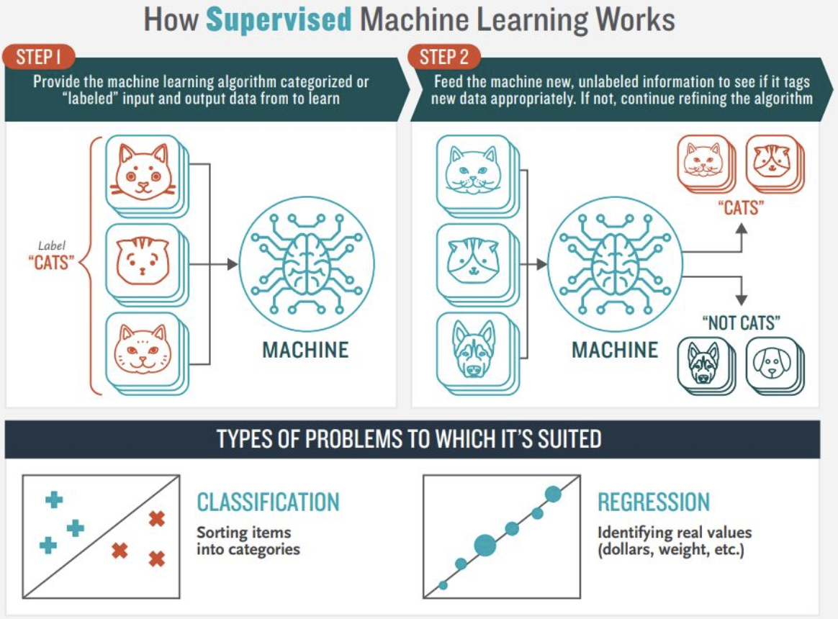
Supervised Learning
Supervised Learning is done using a ground truth, i.e., we have prior knowledge of what the output values for our samples should be. Hence, the goal of supervised learning is to learn a function that, given a sample of data and desired outputs, best approximates the relationship between input and output observable in the data.

Slide 6
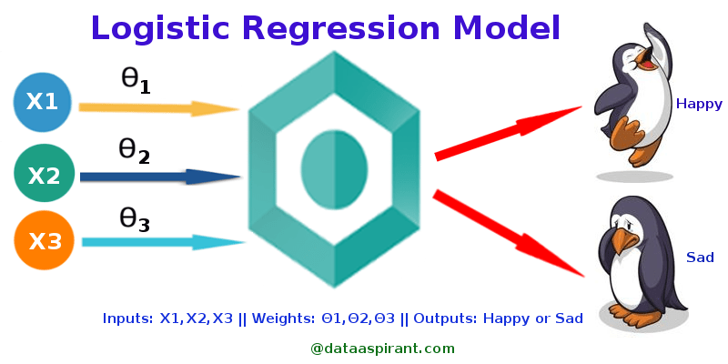
Logistic regression
Logistic regression is a statistical model that in its basic form uses a logistic function to model a binary dependent variable, although many more complex extensions exist.
In regression analysis, logistic regression (or logit regression) is estimating the parameters of a logistic model (a form of binary regression).
Logistic Regression is used when the dependent
variable(target) is categorical.
For example,
To predict whether an email is spam (1) or (0)
Whether the tumour is malignant (1) or not (0)

Slide 7
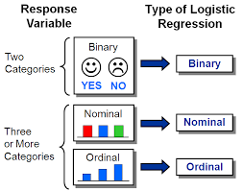
Types of Logistic Regression
1. Binary Logistic Regression
The categorical response has only two 2 possible outcomes. Example: Spam or Not
2. Multinomial Logistic Regression
Three or more categories without ordering. Example: Predicting which food is preferred more (Veg, Non-Veg, Vegan)
3. Ordinal Logistic Regression
Three or more categories with ordering. Example: Movie rating from 1 to 5

Slide 8
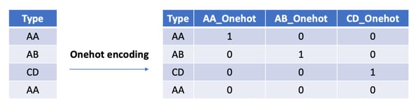
One Hot Encoding
One hot encoding is a process by which categorical variables are converted into a form that could be provided to ML algorithms to do a better job in prediction.

Slide 9
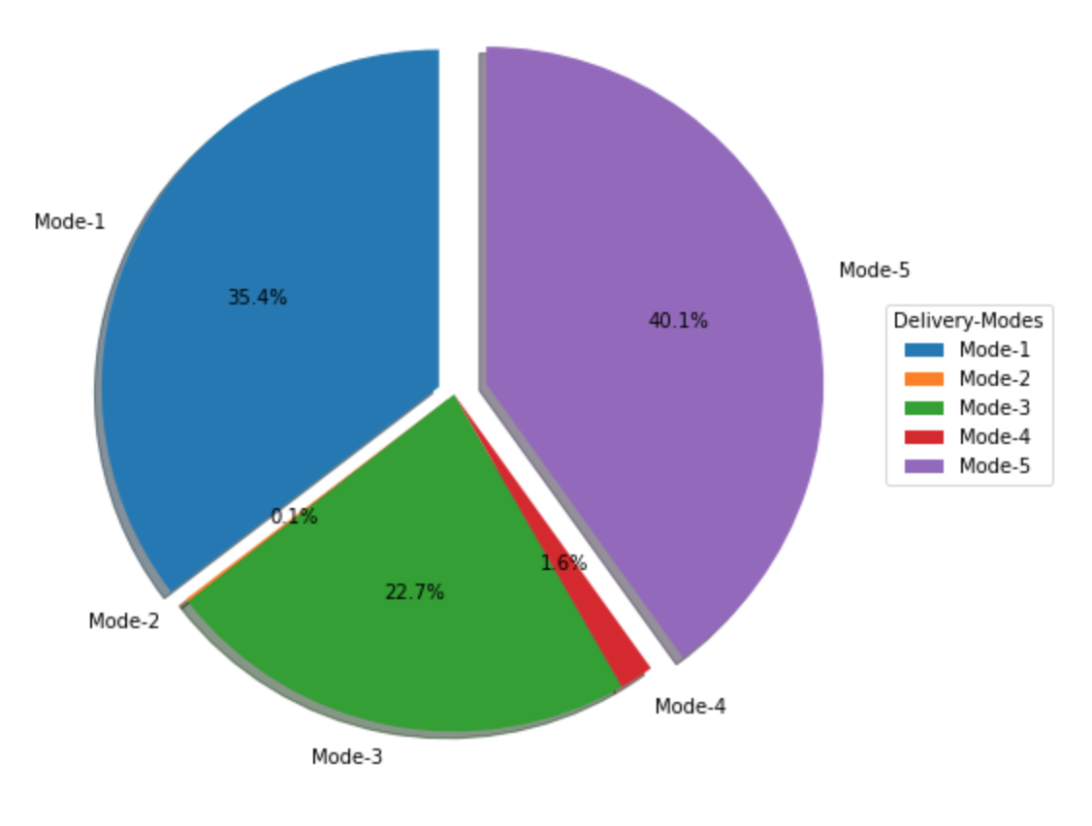
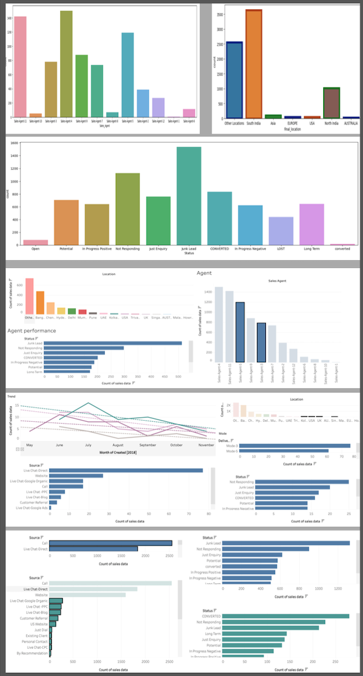
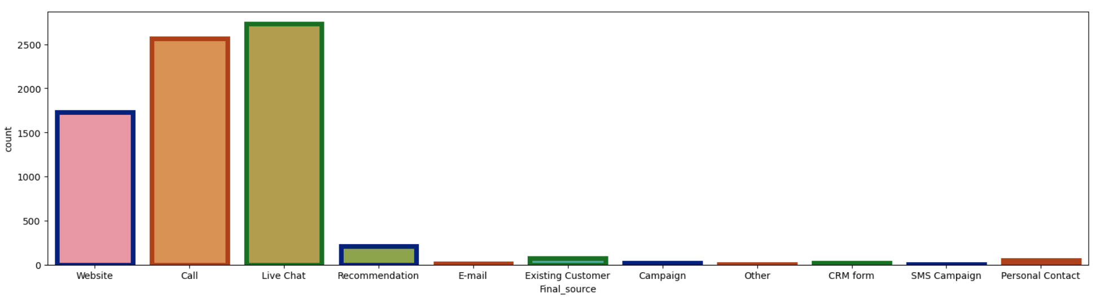
EDA
Finding relationship between features and the labels.
Finding correlations between the features.
Finding the count of the labels.
# Tableau Link:-
https://public.tableau.com/app/profile/ayush.mehta/viz/ClientProjectstory/Story1
A thorough analysis of the data has been done on tableau please have a look at the above link.

Slide 10
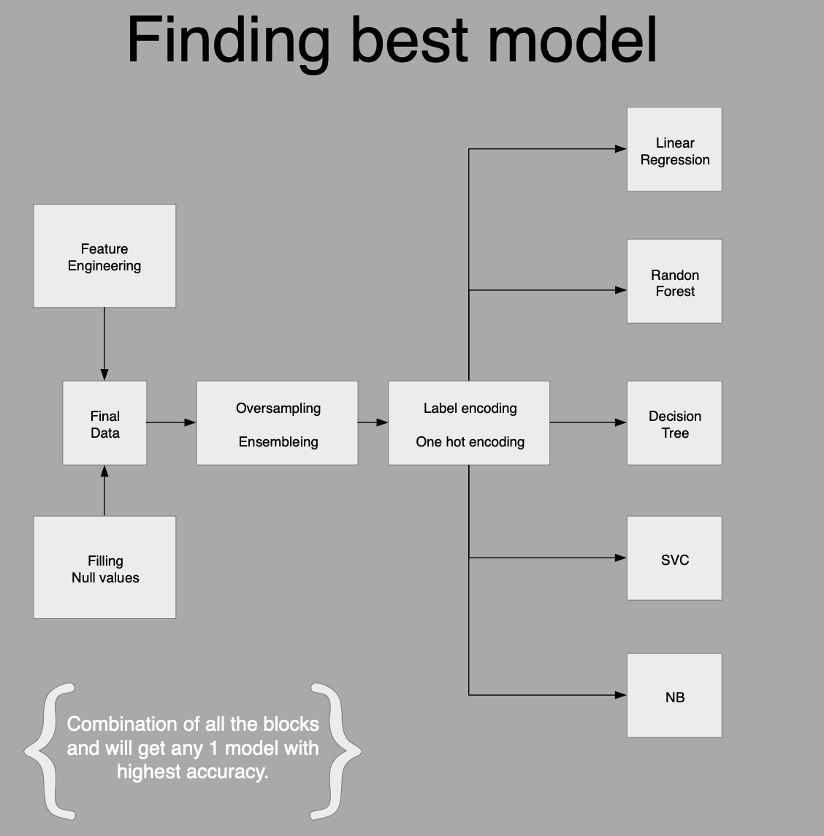

Finding best accuracy model

Slide 11
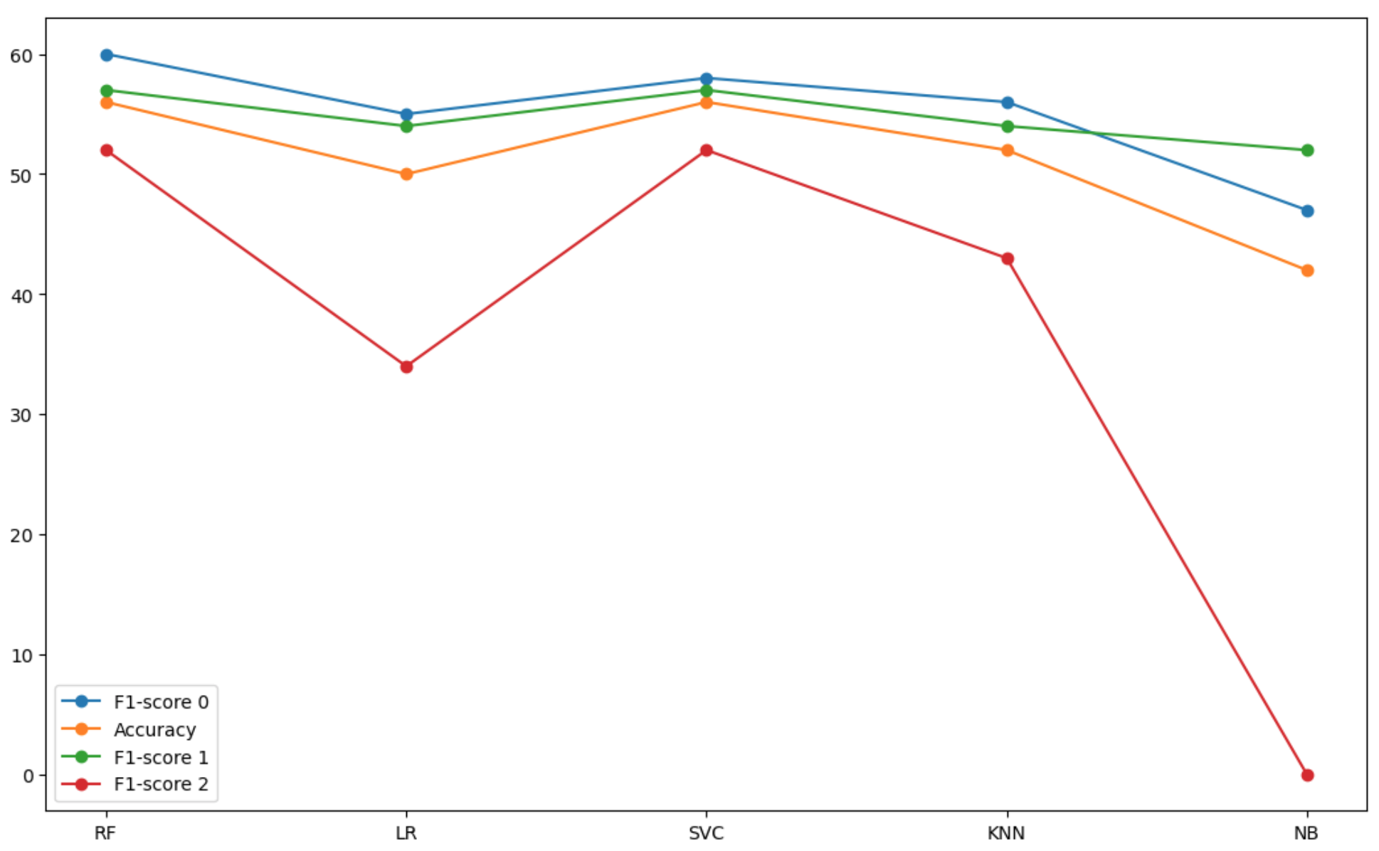
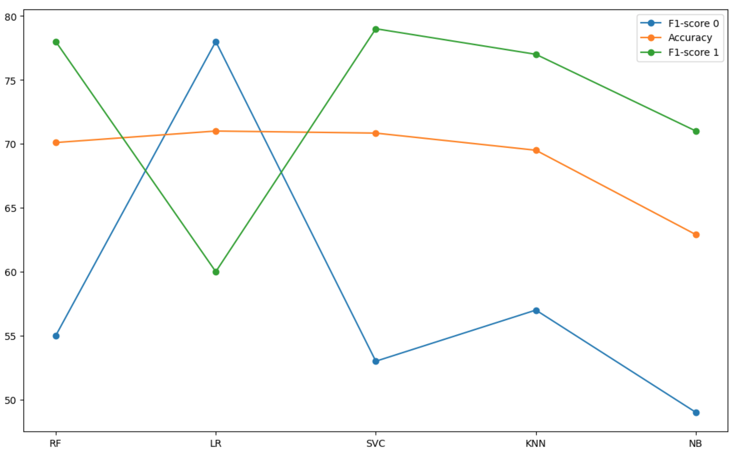
Model selection
Before Feature Eng.
After Feature Eng.

Slide 12
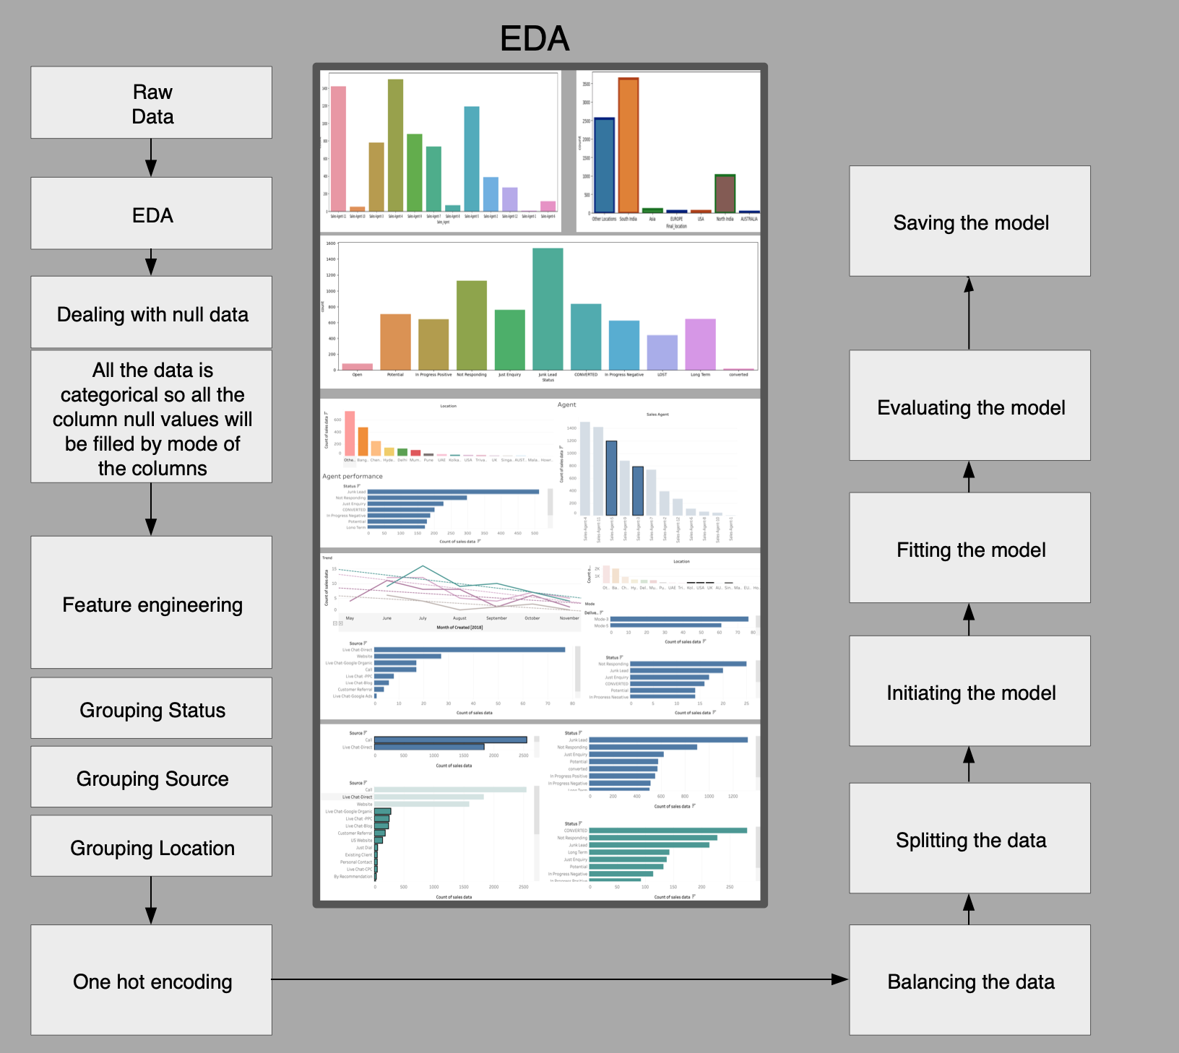
Our Model

Slide 13
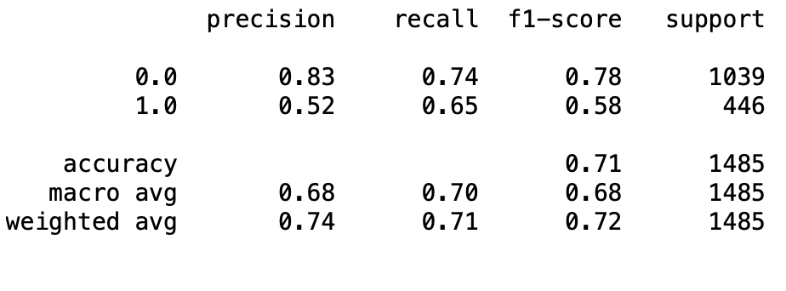
Evaluation

Slide 14
Thank You

